Slide 1


Create a GitHub Repository

Slide 2
Setting Up Your Repository
01
02
03
Create account in Git hub
Create a Repository with name
Copy Repo Url
04
05
Download Git bash
Open folder with Git bash

Slide 3
Initial Git Commands
Write Git Commands
Git clone (for make clone of repo)
Git cd (for main)
These are the fundamental commands to start interacting with your repository.
Change directory to the main branch of your cloned repository.
Use this command to create a local copy of your remote repository.

Slide 4
Committing and Pushing Changes
1
git status (checking status of file )
2
git add .
Stage all changes in the current directory for the next commit.
Always check the status of your files before adding or committing.
3
git commit -m "message" (for commit )
4
git push (push the file into repo )
Commit the staged changes with a descriptive message.
Upload your local commits to the remote repository.

Slide 5
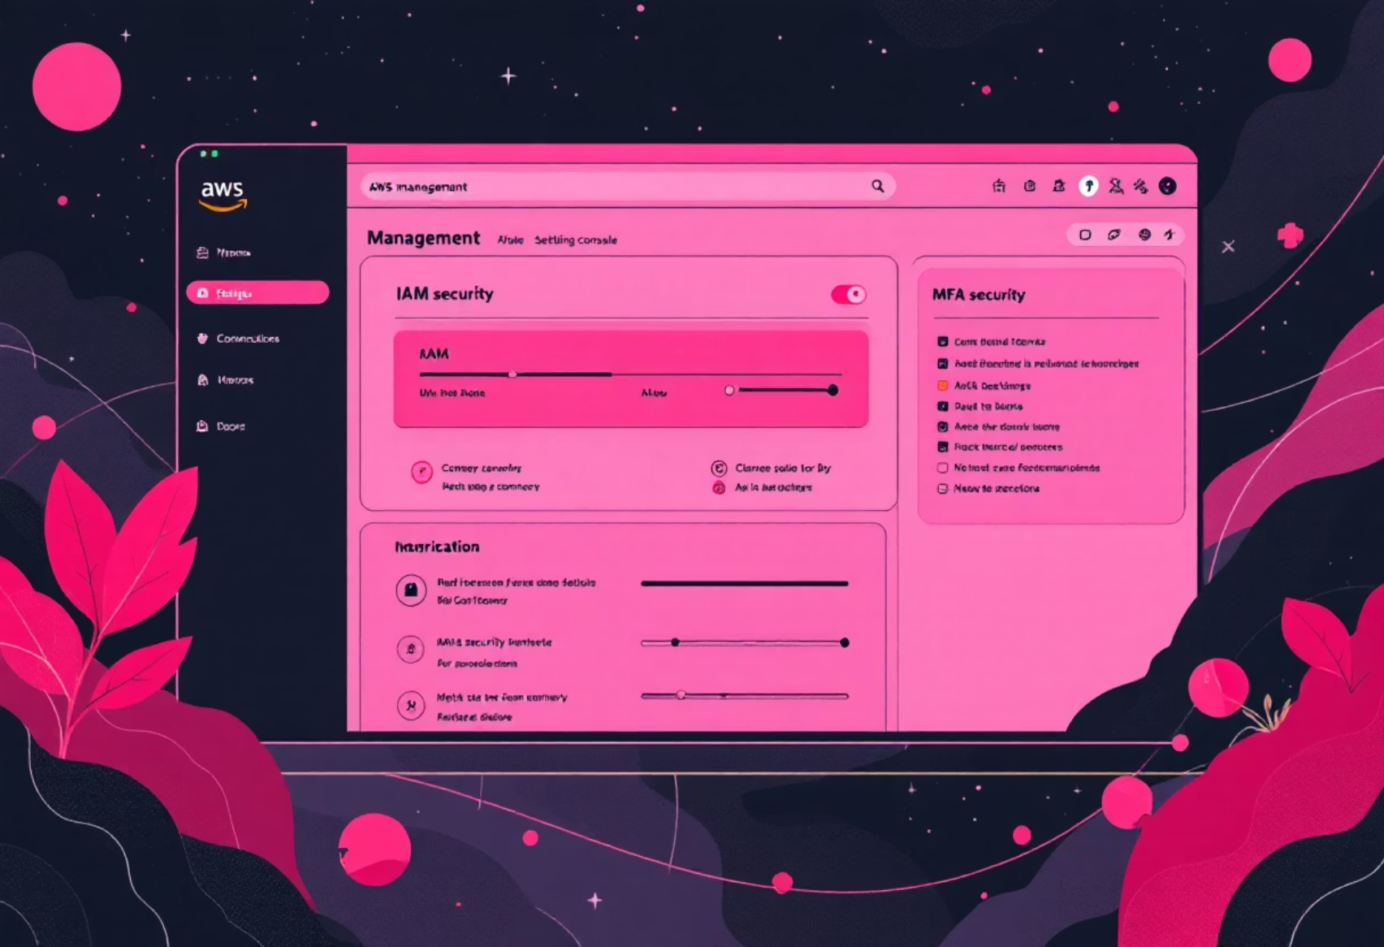
AWS Setup and EC2 Instance Launch
1. Create / prepare AWS account & permissions
2. Launch an EC2 instance
Console → EC2 → Instances → Launch instances.
Sign in to AWS Management Console.
Choose Server: e.g., Ubuntu Server 22.04 LTS (HVM).
Use an IAM user (don't use root). Create one with AdministratorAccess for learning, or least-privilege policies in production.
Choose Instance Type: t2.micro (free tier)
Configure Instance: Number of instances: 1
Enable MFA for your root/AWS account and important IAM users.
Configure security group: create or choose one with rules: SSH (TCP 22), HTTP (TCP 80) —, HTTPS (TCP 443)
Key pair: create new key pair (PEM) or use existing. Download .pem file and keep it safe.
Click Launch.

Slide 6
Ci / Cd pipeline Configuration
Setting up the Continuous Integration/Continuous Deployment pipeline requires connecting the EC2 instance and configuring GitHub secrets.
1
Connect Ec2 to local device server
cmd : ssh -i <tempfile> user@ip
2
Developed code allow with YML file
Ensure your deployment configuration is defined in a YML file.
3
We have to push the local developement Code to repo .
The latest code must be available in the remote repository.
4
We have to Configure the setting of git hub :
Access the repository settings to manage secrets.
Secret :
5
Create EC2_USER( NAME OF SERVER )
EC2_SSH_key ( PASTE ALL TEMP FILE CONTENT)
EC2_HOST (PASTE IP OF INSTATNCE )
6
Then push the code into repo .
7
We can check the status of Git hub repo in action side .

